Slide 1

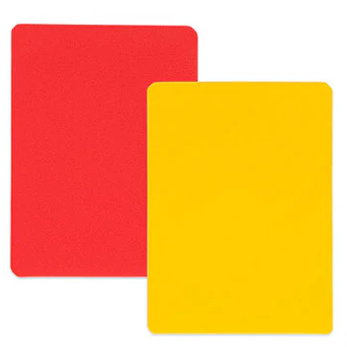
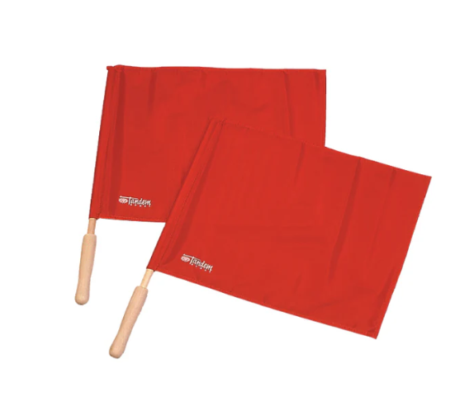
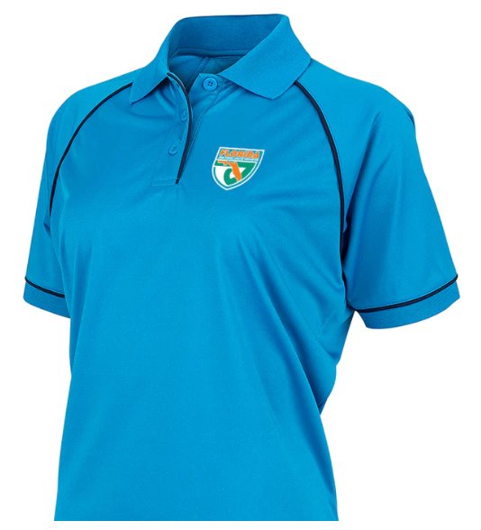
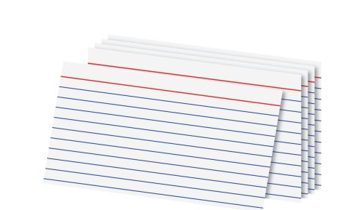
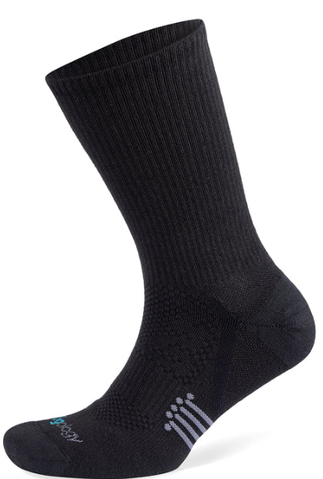
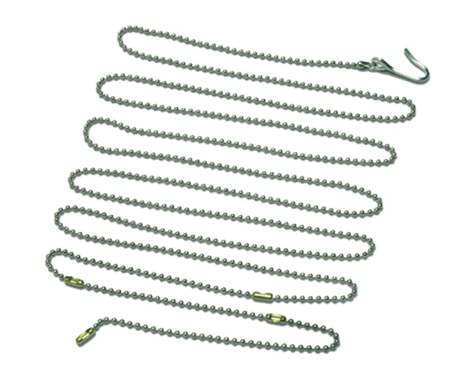

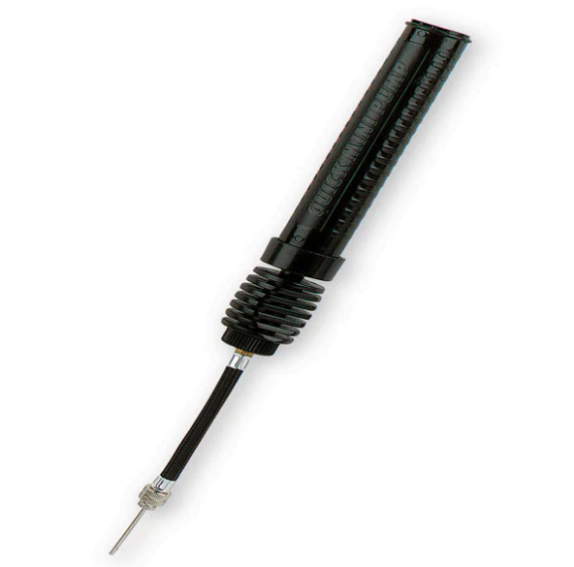


Volleyball Uniform and tools

Slide 2
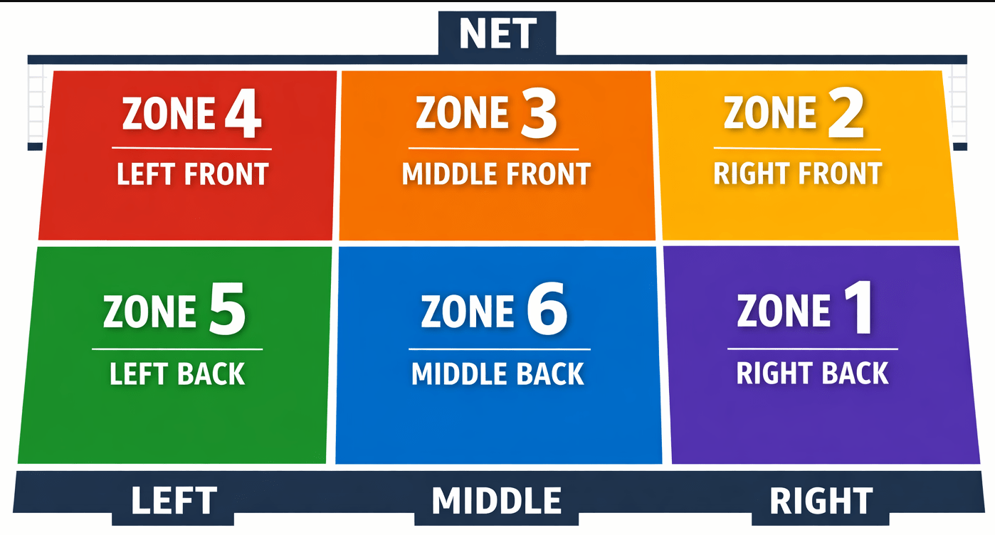

Slide 3
Fundamental rules of volleyball
Only 6 players on the floor at any given time: 3 in the front row and 3 in the back row.
Points are made on every serve for the winning team of the rally (rally-point scoring).
Players may not hit the ball twice in succession (a block is not considered a hit).
Ball may be played off the net during a volley.
A ball hitting a boundary line is in.
A ball is out if it hits an antennae, the floor completely outside the court, any of the net or cables outside the antennae, the referee stand or pole, or the ceiling above a non-playable area.
It is legal to contact the ball with any part of a player’s body.
It is illegal to catch, hold or throw the ball.
A player cannot block or attack a serve from on or inside the 10-foot line.
After the serve, front-line players may switch positions at the net.
Matches are made up of sets to 25, must win by 2.

Slide 4
Ball Handling
Bump (forearm pass)
Set
Spike
Dig

